Slide 1
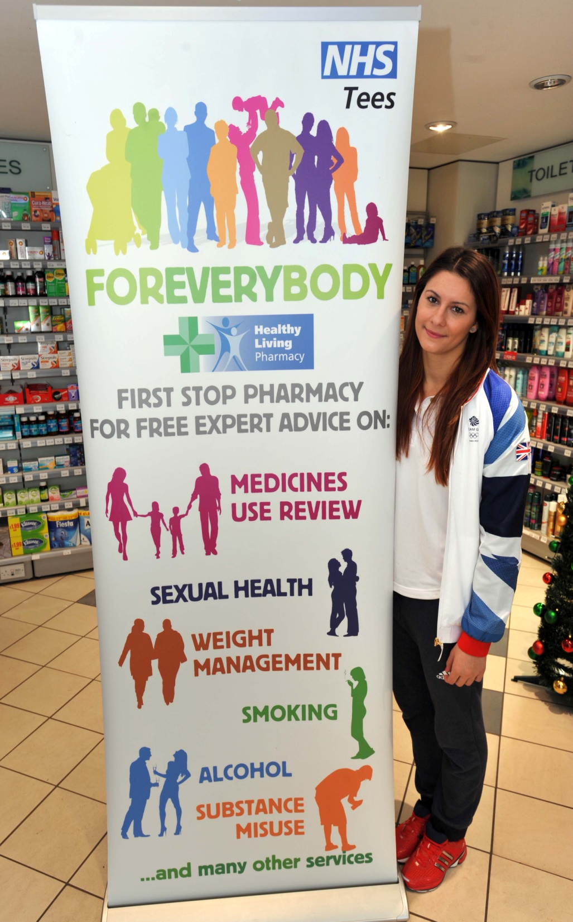
Health Champions Event

Slide 2
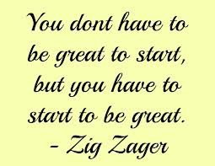
Agenda
Welcome and Introduction
HLP what it means to your patients/customers
What are the key factors that turn a member of staff into a champion?
View of stands and examples of health promotion zones
Gaining confidence in the approaching the customer on difficult issues
Signposting and referral
Ask the Champions

Slide 3
Welcome and Introduction
Before HLP began what did you think it was?
What is it now?
What would you like it to be?
What do your customers want from you?

Slide 4
Quality Payments
Gateway Criteria must be met but do not attract a payment in their own right
At least one advanced service
NHS Choices up to date
Ability to send and receive NHS mail
Ongoing use of EPS
£75m goes towards quality payments
Two review points – End April 17/End November 17
100 points available with potential £64 per point
Criteria to be discussed further
3 of them need to be met once only during the year
Patient safety
Patient Experience
HLP Level I

Slide 5
Healthy Living Pharmacy Level I
Trained Leader
1 Trained Champion – RSPH Level II Understanding Health Improvement
Health Promotion Zone – 6 campaigns
Awareness of local health needs
Proactive delivery of public health advice
Actively engages with GP surgeries

Slide 6
A Great Leader Inspires a Great Team

Slide 7
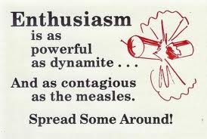
What are the factors that turn a member of staff into a champion?
Has the RSPH Understanding Health Improvement Level 2 award
Engage proactively with the public
Understand what’s available locally
Signpost to local health and wellbeing services and national support
Establish and maintain health promotion zone
Put in place health promotional activities
Outreach into the local community
Deliver health and wellbeing services
A champion is not the end of the story

Slide 8
The Peas Effect

Slide 9
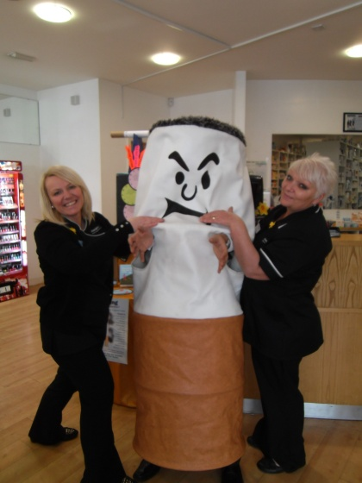
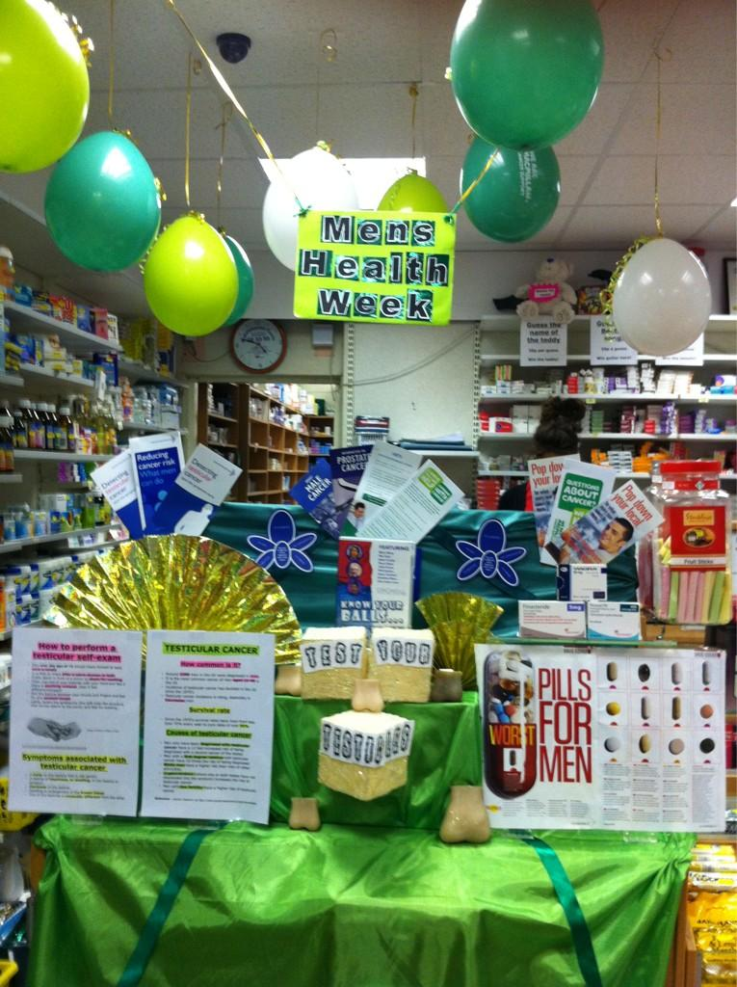
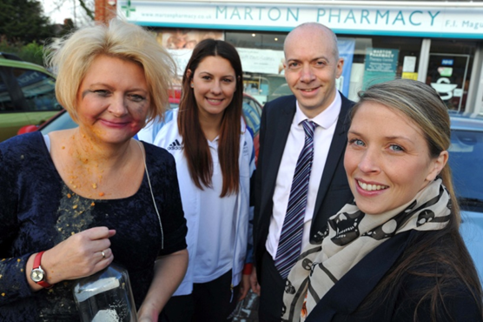
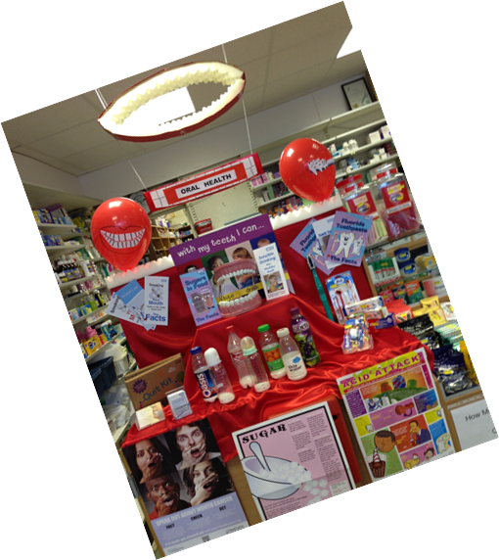
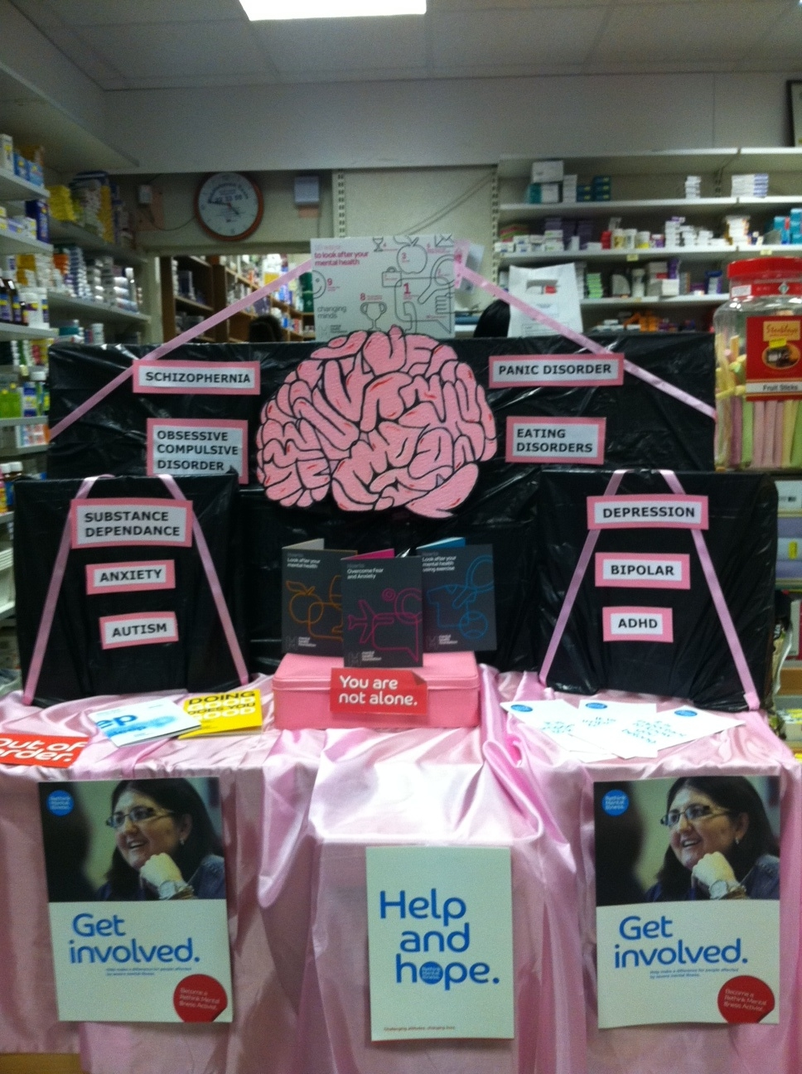
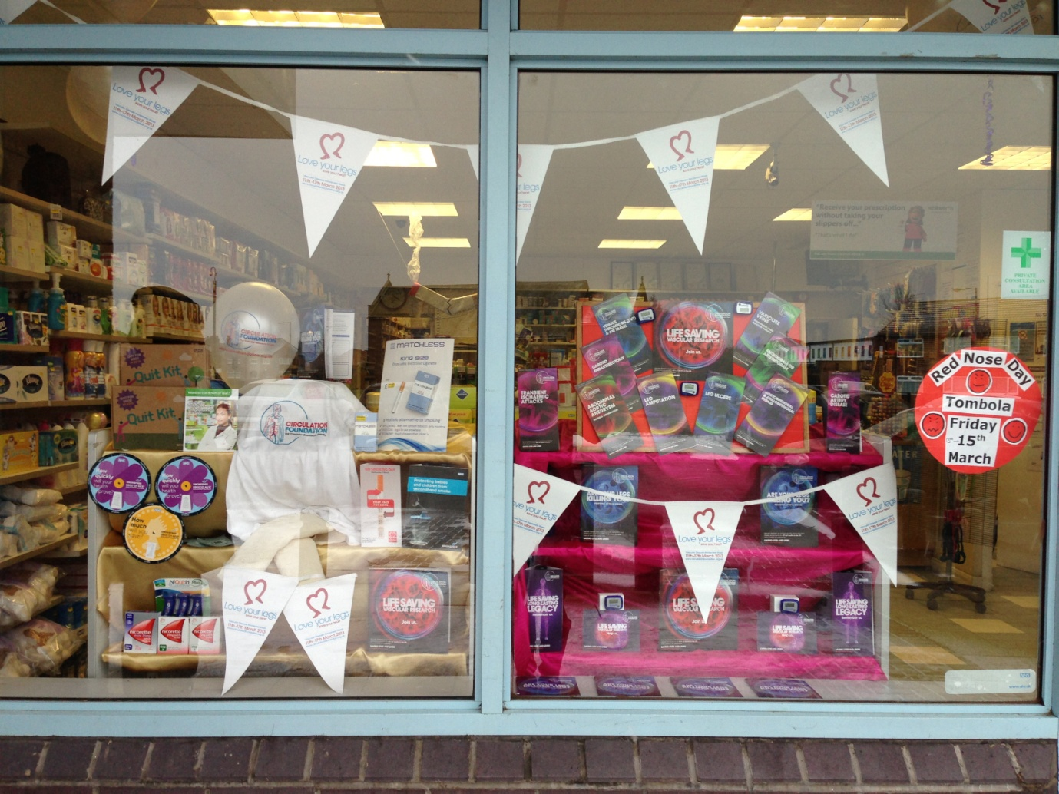
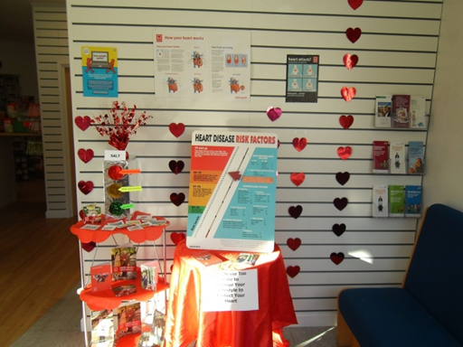
Health Promotion Zones

Slide 10
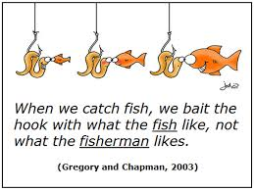
Gaining confidence in approaching the customer on difficult issues
Do you have a good knowledge of the issues?
Are you comfortable discussing the issues you want to raise?
Do you know what the aim of the conversation is?
Are you on the customers agenda?
Are you prepared a the no?

Slide 11
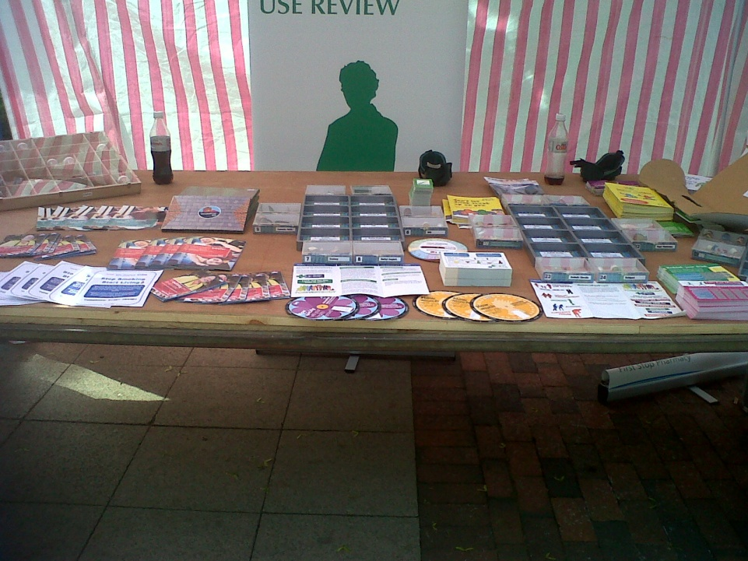
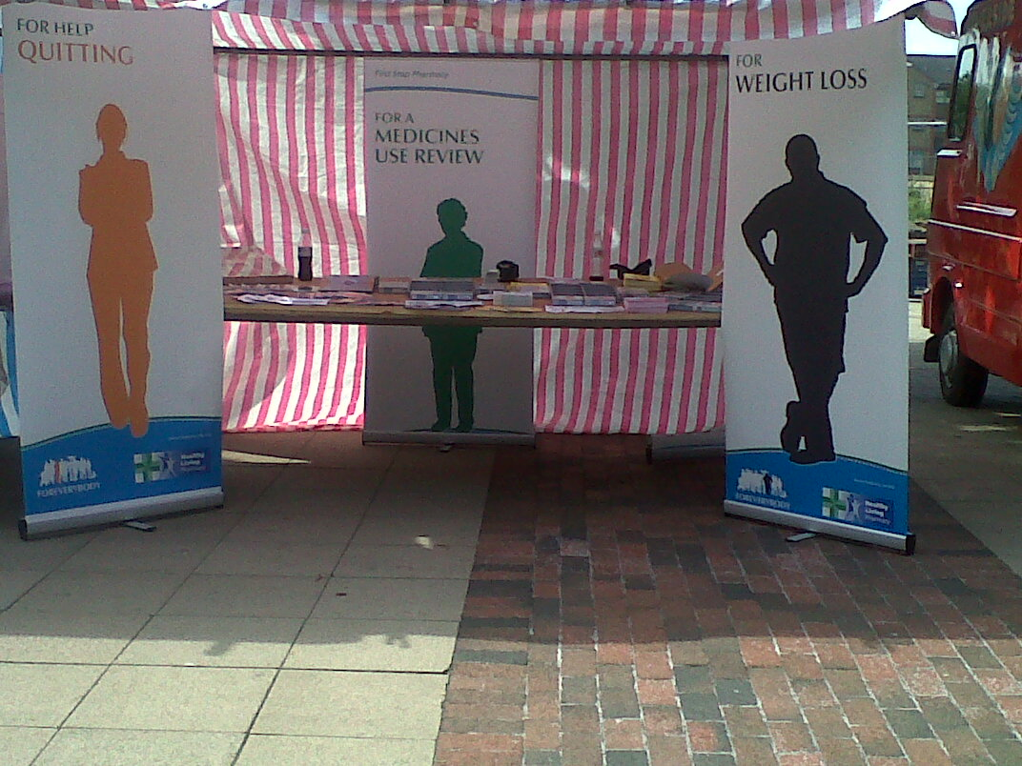
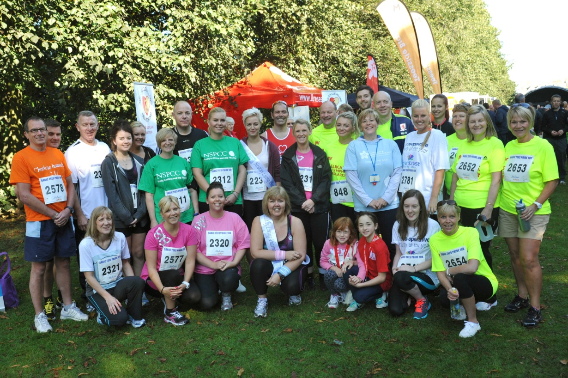
Public Engagement
Tees Pride 10k: Pharmacists lead by example in Middlesbrough road race
A team of health workers will practise what they preach this Sunday when they take part in the SABIC Tees Pride 10k
Saltburn Health News

Slide 12
Signposting and Referral
Know your local specialist services
Know how to refer
Know the times your customers can access the services
Have the information available both verbally and written

Slide 13
Ask the Champions

Slide 14
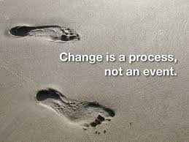
Change Management
C H A N G E
C - Choose change
H- Have a vision (and share it)
A- Action plan
N- Now (make it happen for quick wins)
G- Give ownership
E - Embed change

Slide 15
Any Questions?

