Slide 1
Gateshead and South Tyneside LPC
Substance Misuse Update for Community Pharmacy Providers in Gateshead and South Tyneside
29th April 2024
Notes:
LPC t o do initial introductions/ formalities re the evening - 5mins

Slide 2
Substance Misuse Update for Community Pharmacy Providers in Gateshead and South Tyneside
Agenda:
Key Headline data regarding substance misuse
Drug Related Deaths; The Coroner’s viewpoint
Synthetic drugs: Nitazines
Naloxone
Brief intervention: alcohol
Lived experiences
Breakout groups: Local commissioning issues/ discussion
Gateshead Recovery Partnership
South Tyneside Adult Recovery Service
Notes:
Sue – happy to present this section

Slide 3
Substance Misuse Key Headline Data
Gateshead & South Tyneside
Julia Sharp; Gateshead
Julie Connaughton; South Tyneside
Notes:
Julie and Julia to present this section – 10mins in total

Slide 4
ONS: Drug Related Deaths

Slide 5
ONS: Drug Related Deaths
Number of deaths related to drug misuse 2020-22
Newcastle: 106
Gateshead: 71
South Tyneside: 45
North Tyneside: 56
Sunderland: 67
Northumberland: 39

Slide 6
Prevalence and unmet need

Slide 7
NDTMS: Adults in treatment - Gateshead

Slide 8
NDTMS: Young people in treatment -Gateshead

Slide 9
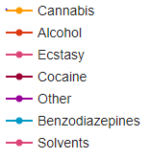
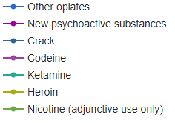
NDTMS: Young people in treatment - Gateshead Alcohol and other Substances

Slide 11
Northumbria Police Data: Drug Related Deaths
Suspected DRDs
9.2% increase force-wide
Increases in South Tyneside, Sunderland and Newcastle
Decrease in Gateshead
Stable rates in Northumberland and North Tyneside
 | Misadventure | Intentional overdose
Change from 2022 to 2023 | 10% increase | No significant change
Proportion of all DRDs | Three quarters | One quarter
Most common age group | 31-40 years (note: 6 deaths <21 years) | 60+ years
Gender | 83% male | 71% male
Toxicology (top 3) | Pregabalin, cocaine, diazepam | Cocaine, morphine, mirtazapine
Extra misadventure notes:
92% showed evidence of poly drug use
Reduction in illicit benzodiazepine detected in toxicology: 32% in 2021, 34% in 2022, 17% in 2023

Slide 12
Drug Related Deaths – Coroner’s update
Cocaine, Diazepam, Pregabalin
Early 20’s to 50’s
Some (most) cases multiple drugs present
56 deaths positive tox
Prescence of other drugs but Cocaine primary cause
Rise in synthetic benzos, e.g. bromazolam
Not ‘typical’
Because not cause

Slide 13
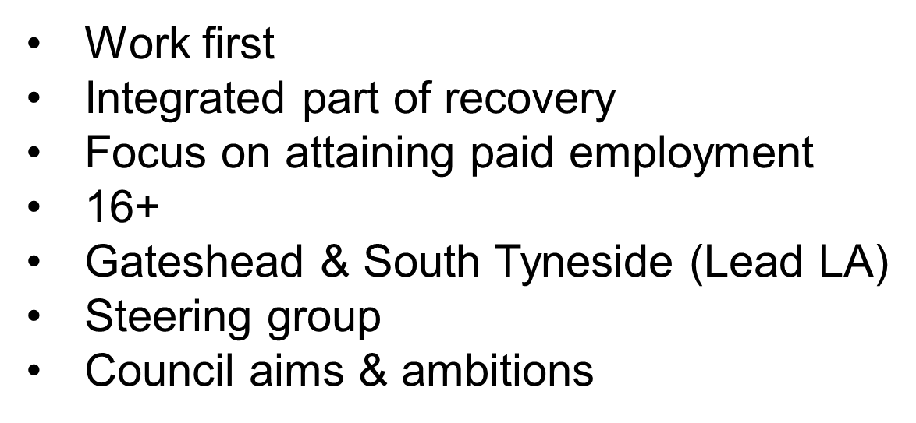
Individual placement & Support (IPS)

Slide 14
Individual placement & Support (IPS)
100+ job starts
Attainment
Sustainment
Supported
Engagement

Slide 15
New Synthetic Opioids (NSOs) Training
A clear and present danger
Sarah Beat – Service Manager, Gateshead Recovery Partnership

Slide 16
Purpose of Session
Understand ‘new’ drugs entering/changing the drug market
Recognise the context and impact of these changes
Learn ways to support people who may encounter new substances

Slide 17
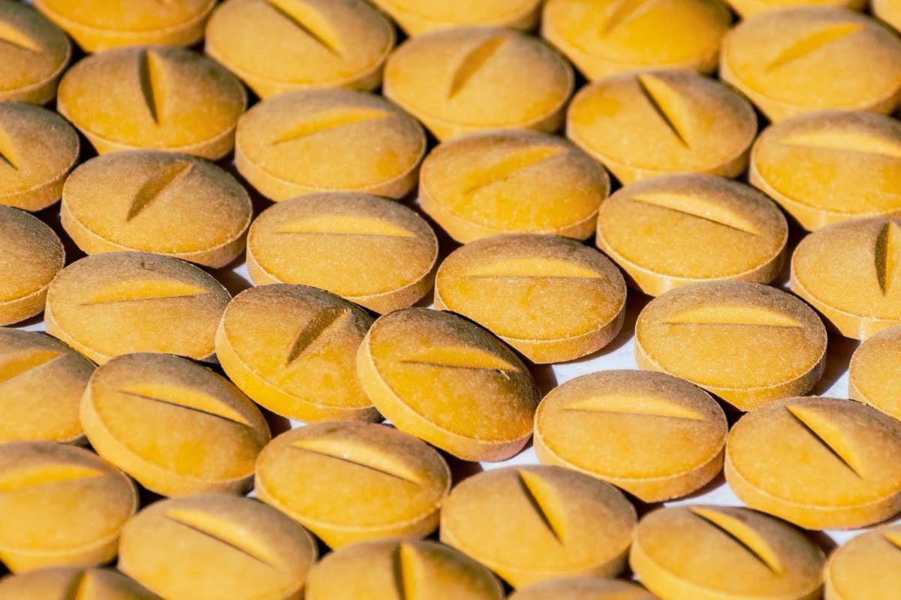
What are Nitazenes?
Nitazenes are synthetic opioids - laboratory-produced drugs which act on the same receptors in the brain as morphine and heroin.
In the UK, nitazenes have been detected in other substances sold as other opioids, like heroin and oxycodone; benzodiazepines, like diazepam; cocaine and cannabis products.
Some nitazenes are x1000 stronger than heroin, so people who use them inadvertently – even in small amounts – are at high risk of overdose.

Slide 18
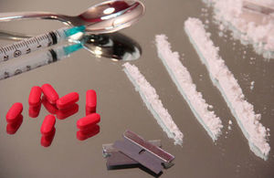
How are they used?
Nitazenes are being used adulterant in the UK illicit supply, not as a drug of choice
NSOs are mainly being seen in illicit opiates
NSOs have also been found in a range of non-opiate drugs
People who use drugs are unknowingly taking NSOs sold as something else
NSOs are sometimes used as a cutting agent
Self-Test strips are available for Nitazenes, Xylazine and Fentanyl

Slide 19
What is the context?
4,907 drug-poisoning deaths registered in 2022. 1% increase on 2021.
Highest rates in those aged 40 to 49 years, a decrease for males and an increase for females.
Novel Opioids related deaths has increased from 3 to 39, registered in 2022, so won’t account for recent nitazenes deaths in 2023/24.
This represents a growing Public Health Crisis & the highest number ever reported since records began in 1993.
The ONS report of drug poisoning deaths registered in 2022 in England and Wales (released 19/12/2023).
Notes:
Among males, there were 114.3 drug-poisoning deaths registered per million, compared with 55.8 deaths per million among females (1,667 deaths). Overall, a decrease for males and an increase for females.
next

Slide 20
How is the drug market changing?
Increased levels of fatal overdose in 2023 and large clusters of NFO early 2024
Increased reports of higher prevalence of New Synthetic Opiates (NSOs) , in both opiate and non-opiate illicit supply (wedinos)
Research: (ALCIS, WHO, David Mansfield) shows sustained issue
Intel from NCA/Border Force/Customs; seizures, cutting agents and availability
Heroin decreased in purity
Using unmet need data, we can see the potential for increased referral rates for structured treatment

Slide 21
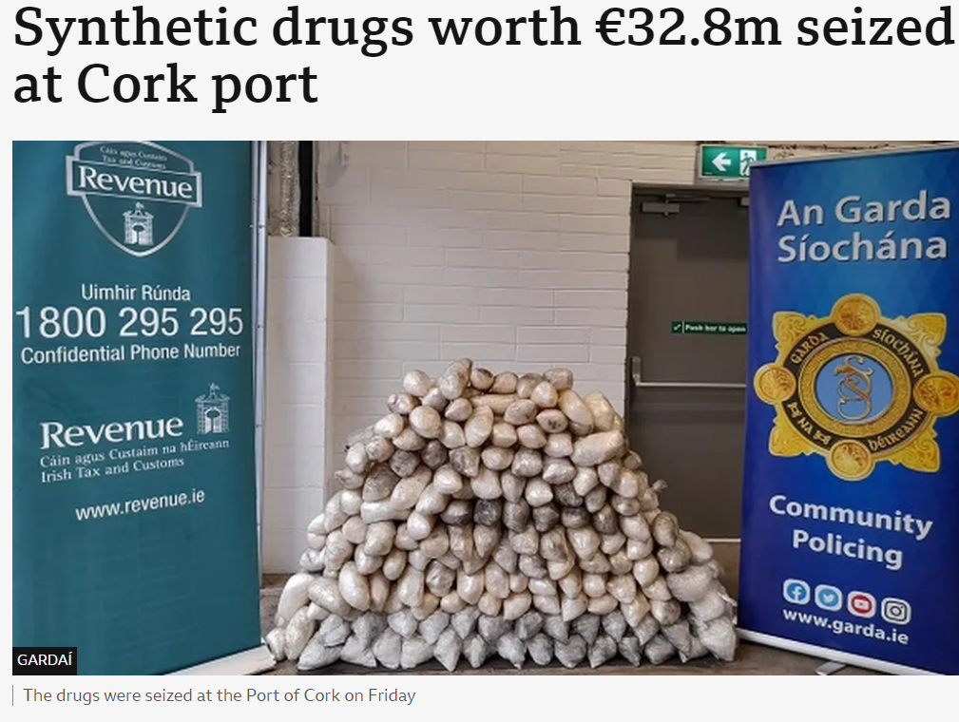
How is the drug market changing?

Slide 22
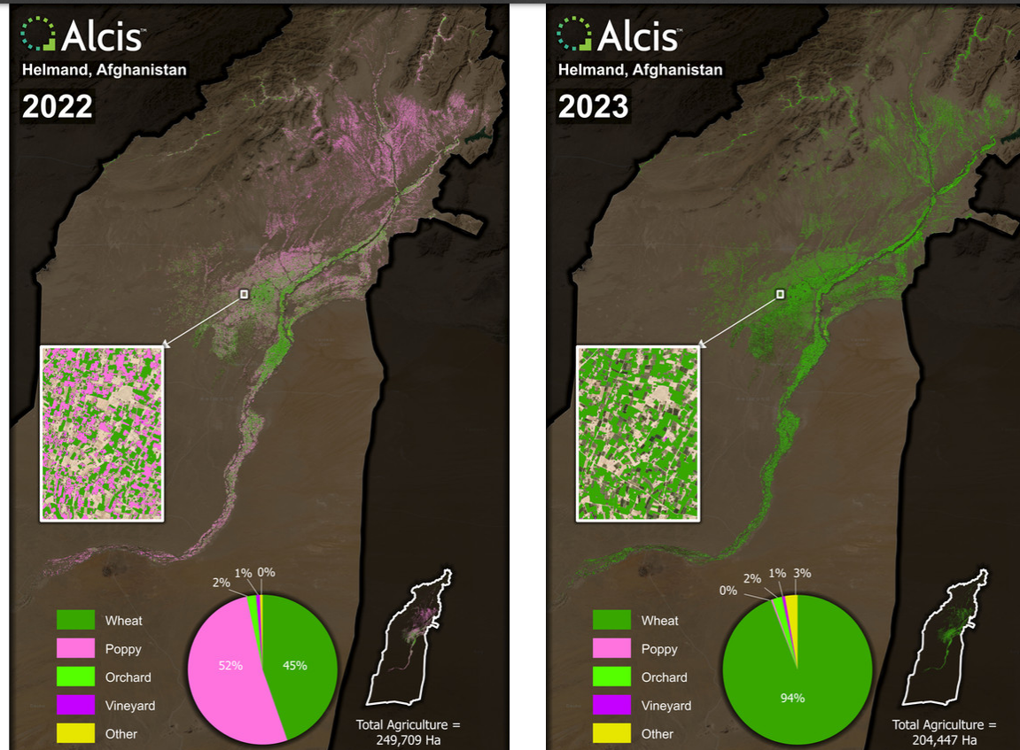

Slide 23
What is the scale of the problem?
Unfortunately, we don’t know the scale of the problem.
Most laboratories don’t routinely test for novel or uncommonly used drugs.
Deaths recorded as related to heroin or other common drugs might also have taken Nitazenes or other substances which have gone undetected.
Xylazine and Fentanyl are also a risk and are present to some extent in the drug supply
Currently, National Crime Agency don’t see new routes/supply coming into Europe from South America

Slide 24
‘September 2024’?
We may see the following for September 2024
Heroin will either:
Not be available
Heavily cut with NSOs
Too expensive for many people who use drugs
Based on 2023 OD stats & North American experience, overdoses will continue to increase in this environment.
Based on levels of Heroin and Crack use this puts 300,000 people at risk
Failed on drug strategy targets on preventing 1000 DRDs.

Slide 25
Who is at most risk?
Long-term heroin users (highest number of NFO/deaths) who use alone (60% fatal OD when people use alone)
People in treatment using on top = approx. 11,400 (22.5%)
Non-opiate users exposed to Nitazenes and not prepared for the risks
People who use drugs and are not in treatment

Slide 26
What are we looking to do at GRP?
Development of NSO ‘Comms Planning’ (such as this)
Services to use NSO guidance to carry out ‘desktop’ exercise to stress test NSO guidance in service
Research Team to provide support to capture learning from Level 3 areas
Organisational ‘Level 4’ response to be developed
Feedback into ‘organisational health check’ space
NSO guidance amendment for Homelessness/Street Outreach services
Drug Strategy Ops Forum to be used to collate intelligence

Slide 27
How can we prepare/ plan?

Slide 28
What must services do?
Maximise the opportunities of engaging new people not in treatment
Increase and promote conversations about optimised dosing
Increase the distribution & carriage of naloxone
Provide route transition interventions to PWID
Make sure we are giving Harm Reduction advice, making every contact matter

Slide 29
Naloxone
Barbara Rowan Programme Lead – Substance Misuse, Public Health Team, Gateshead Council
Notes:
Barbara – 5 mins (and 5 mins IBC alcohol)

Slide 30
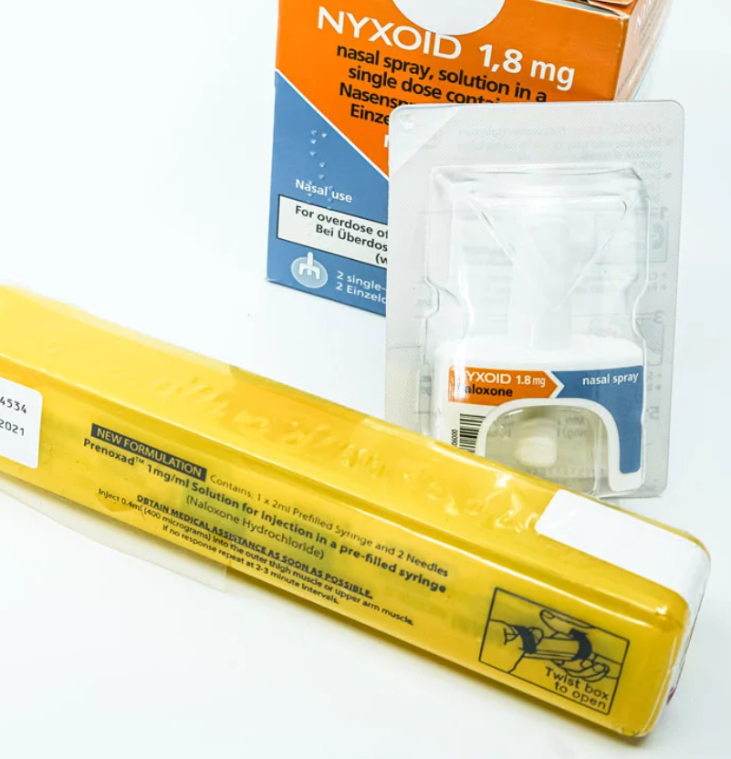
Naloxone
Naloxone is an emergency antidote to opioid overdose. In the event of a suspected opioid overdose naloxone can temporarily reverse the life-threatening effects of an overdose of opioids such as depressed breathing. Naloxone begins working within a few minutes however it only works for a short period of time, approximately 20 – 30 minutes. After that, a person can go into a state of overdose again, which is why it is important to call for emergency help straight away.
Naloxone itself has no psychoactive properties and so has no intoxicating effects or misuse potential.
With drug-related deaths continuing to increase, there continues to be a national focus on increasing the availability of naloxone. The 2021 RPS report Improving care, reducing harm, and preventing death in People Who Use Drugs: Naloxone to be available from every community pharmacy for supply to people who use drugs.

Slide 32
Naloxone 1mg/ml solution for injection in a pre-filled syringe (Prenoxad®)
Yellow plastic box containing 1 x 2ml pre-filled syringe containing 1mg/ml solution and 2 x needles
Indicated for adults and adolescents aged ≥16 years old
Dose: give one dose (400 micrograms) intramuscularly into the outer thigh muscle or upper arm muscle. Dose can be repeated every 2–3 minutes depending on response to treatment.
One Syringe contains a total of five x 0.4ml doses.

Slide 33
Naloxone 1.8mg nasal spray (Nyxoid®)
2 single-dose nasal sprays
Indicated for adults and adolescents aged ≥14 years old
Dose: 1.8mg administered into one nostril (one nasal spray); if no response second dose should be given after 2-3 minutes; if response to first dose, but relapses into respiratory depression, administer second dose immediately

Slide 34
Widening the availability of naloxone
The importance of naloxone is apparent, with evidence showing an association between administration of naloxone and a reduction of opioid overdose-related deaths.
There has been an increase in the number of people who have been administered naloxone over the last ten years.
Pharmacies are a key provider of take-home naloxone, and a UK agreement on the specific role of community pharmacies in distributing naloxone promotes collaborative working across the United Kingdom.
Evidence suggests that the supply of take-home naloxone on release from prison is fragmented across the UK, with only a small proportion of opioid-dependent prison leavers currently being provided with naloxone, even though studies find that a high percentage of these people would willingly accept take-home naloxone upon prison release.
There are multiple police service pilot programmes across the UK which currently deliver intranasal naloxone (Nyxoid) as a more convenient method as opposed to intramuscular devices.
Naloxone (Prenoxad) injection, take home kits will be available via participating pharmacies in Gateshead.

Slide 35
Naloxone Distribution from Pharmacies
Gateshead Participating Pharmacies

Slide 36
What we aim to achieve, supplying naloxone (Prenoxad) from pharmacies is:
REDUCTION IN DRUG RELATED DEATHS.
INCREASED KNOWLEDGE AND UNDERSTANDING OF NALOXONE IN RELATION TO PREVENTION OF OPIOID OVERDOSE.
INCREASED PROVISION OF NALOXONE IN THE LOCAL COMMUNITY.

Slide 37
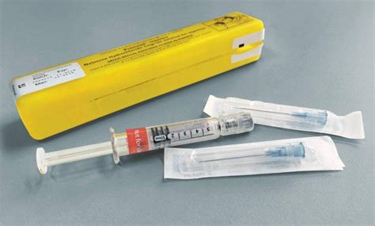
Within the specification for naloxone supply via Gateshead pharmacies, is Prenoxad pre-filled injection take home kits are the identified product for distribution.
Who can be supplied naloxone (Prenoxad)
Person requesting naloxone is over 18 and resides in Gateshead and is either:
A person currently or has a history of using opioids
A carer, family member or friend who is liable to be on hand in the event of an overdose.
If the person is under 18 years and requesting Naloxone. Consider signposting to Positive Futures
Under the Regulations, it is legal for a drug service to provide a family member / friend / carer of an opioid user with naloxone without the express permission of the individual who is using the opioid, if it is being supplied to save life in an emergency.

Slide 38
Training for the supply of Naloxone
Training
All pharmacists and registered technicians providing the service of naloxone (Prenoxad) supply have completed the training specified within the service specification before supplying any person with naloxone (Prenoxad).
All pharmacy staff providing re-supplies have completed the training specified in the service specification before supplying any person with naloxone (Prenoxad).
They will keep up to date with guidance / service changes (via information circulated on PharmOutcomes) and cascade this to other members of staff providing the service.
All information and links to required training Schedule 1 – sect 3.

Slide 39
Identification and Brief Advice (IBA) Alcohol Pharmacies
Gateshead Participating Pharmacies

Slide 40
Alcohol Related Hospital Admissions 21/22
Gateshead has the 10th highest rate of alcohol specific admission to hospital in England and the 4th highest in the North East.
Gateshead is significantly higher than the North East average and is also significantly higher than the England average with an average for Gateshead of 1106 per 100,000 population.
Alcohol Deaths:
In 2020, 1 in 3 of all alcohol specific deaths occurred in the most deprived 20% of the population, widening health inequalities.
In, 2021 there were 20,970 alcohol related deaths in England, this is a rate of 38.5 per 100,000 population.
The mortality rate in the North East region was 50.4 per 100,000 population.
In Gateshead, the mortality rate was 44.8 per 100,000 population.
Mortality from chronic liver disease (all ages) 17/19:
Overall mortality from liver disease in Gateshead is 18.3 per 100,000 population, compared to a NE rate of 18.7 and the England rate of 12.2

Slide 41
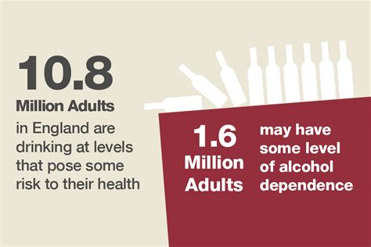
Evidence shows 24% of adults regularly drink over the recommended low risk guidelines.
Alcohol misuse is the biggest risk factor for premature death, ill health, and disability
amongst the 15–49-year-olds in the UK. Alcohol specific death rates in the UK are highest
amongst 55–64-year-olds.
People who drink alcohol may not be aware of alcohol consumption guidelines, or that they
are drinking over the recommended low-risk amount. They may not know of the risks
associated with higher alcohol intake or misuse of alcohol. Due to this, people who may
benefit from an intervention to reduce alcohol-related harms will likely not present at a
treatment service or other healthcare provider to seek support for their alcohol use.
The Cochrane Collaboration review (2007) shows substantial evidence for the effectiveness
of Brief advice for excessive drinkers in primary healthcare settings. Around 20-30% of
patients who routinely present in Primary Care are estimated to be hazardous or harmful
drinkers. Brief advice can reduce weekly drinking by between 13%-34%.

Slide 43
Health Harms

Slide 44
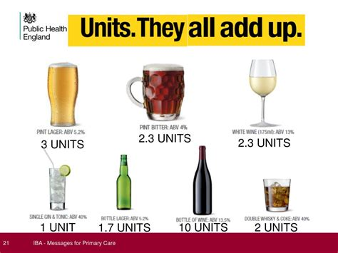
Robust evidence-base of more than 60 controlled trials over 30 years, show that simple structured feedback and motivational advice lasting a few minutes is effective in reducing health risks from alcohol including hypertension, coronary heart disease, mouth, throat and breast cancers and many other conditions. Recipients reduce their alcohol intake by an average of 15% which will return a net saving to the health and social care system.
Community pharmacies are more likely than many other healthcare providers to see people who drink more than the recommended amounts of alcohol and can work in collaboration with substance misuse services to increase the opportunity to identify people drinking at increasing and high-risk levels and deliver interventions to reduce alcohol related harms.

Slide 45
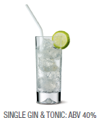
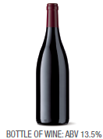
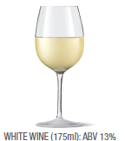
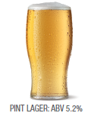
What is an Alcohol Identification & Brief Advice (IBA)?
“ A short, evidence-based, structured conversation about alcohol consumption to motivate and support the individual to think about and/or plan a change in their drinking behaviour in order to reduce their consumption.”

Slide 46
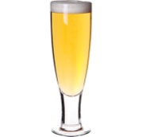
How much impact can YOU really have ?
The Numbers Needed to Treat (NNT) for Alcohol Brief Interventions = 8
The average reduction in alcohol consumption (per week) equates to 4-5 units
Kaner et al (2009) Effectiveness of brief alcohol interventions in primary care populations (review)
Raistrick et al (2006 ) Review of the effectiveness of treatment for alcohol problems.

Slide 47
Gateshead Specific
Gateshead pharmacies can sign up to deliver Alcohol IBA.
Payment claims are outlined in the specification.
Provider to screen using Alcohol Screening Tool (Audit Appendix 1 in the specification.)
The alcohol screening and brief advice to be delivered by a competently trained member of the pharmacy team. ( this does not need to be the pharmacist )
Not included are those accessing alcohol advice via an NHS health check. These are funded through a different contract.
IBA can be undertaken opportunistically or to align with national campaigns such as those promoted by Balance.

Slide 48
Alcohol IBA Learning resources
These resource links can be accessed within the Alcohol IBA Pharmacy Specification – Section 3, Service Delivery. 3.11
Health Education England - alcohol identification and brief advice
RCGP – Learning; Alcohol Management in Primary Care
https://www.e-lfh.org.uk/programmes/making-every-contact-count/
https://www.cppe.ac.uk/gateway/alcohol
Alcohol Users Disorders Identification TEST (Audit) Appendix 1.
Alcohol IBA Pathway – Appendix 2 (includes when to claim payment)

Slide 49
Lived experiences
Amanda Walton : Lived Experience speaker for Gateshead
Cocaine anonymous
Notes:
2 speakers - 15 minutes each
Awaiting confirmation from LPC re names for CA

Slide 50
Any questions?
Notes:
If no time - these can be picked up in the informal discussions with the local teams?

Slide 51
Local commissioning issues:
Local commissioning teams:
Gateshead
Gateshead council; Barbara Rowan and Julia Sharp
Gateshead Recovery Programme (GRP): Sarah Beat
South Tyneside
South Tyneside Council: Julie Connaughton and Paula Philips
South Tyneside Adult Recovery Service (STARS); Mel Scott
Notes:
Group to divide up - about 40 mins for discussions

